Slide 1

vaccination management system
Get yourself vaccinated
Don’t hesitate let’s vaccinate.

Slide 2

Project Members Details
.MUHAMMAD UBAID(Student1452442)
MEHREEN FAIZ (Student1452437)
.NIHA SIDDIQUI (Student1452432)

Slide 3

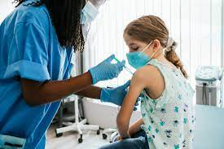
Pages we contain:
HOME
ABOUT
SERVICES
VACCINATION
TEAM
APPOINTMENT
CONTACT US
Admin
hospital
parents
Portals:

Slide 4

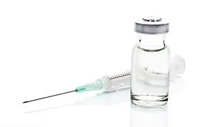



Features of our website:
Pages we contain:
ADMIN
HOSPITAL AND PARENTS:
. Admin portal:
1. Dashboard
2. Parental info
3. Hospital records
4. charts
Without login:
1. Home
2. About
3. Service
4. Vaccination
5. Team
6. Contact
Hospital portal:
1. Home
2. Show records
3. My profile
4. Vaccination
.

Slide 5


Benefits of Vaccination:
Disease Prevention:
Provide statistics on the reduction of diseases through vaccination
Highlight success stories (e.g., eradication of smallpox)
Individual Protection:
Discuss how vaccines protect individuals from severe illness and complications
Mention specific vaccines and their impact (e.g., measles, polio)
Community Protection:
Emphasize the role of vaccination in protecting vulnerable populations
Discuss how high vaccination rates benefit the entire community

Slide 6

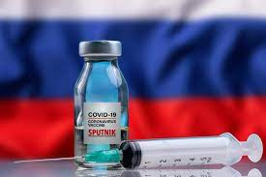


Types of vaccination:
Influenza (Flu) Vaccines:
High-Dose Flu Vaccine:
Specifically designed for individuals aged 65 and older to provide a stronger immune response.
Quadrivalent Flu Vaccine:
Protects against four different influenza virus strains, offering broader coverage.
Pneumococcal Conjugate Vaccine (PCV13):
Protects against 13 strains of the bacterium Streptococcus pneumoniae.
Often recommended for children and adults with certain medical conditions.
Pneumococcal Polysaccharide Vaccine (PPSV23):
Provides additional coverage against 23 strains of Streptococcus pneumoniae.
Recommended for adults over the age of 65 and individuals with certain health conditions.
Prevnar 20 (PCV20):
A newer version that covers an extended range of pneumococcal strains.

Slide 7
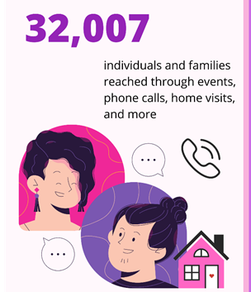

WHY ONLINE VACCINATION REGISTRATION ARE MORE convenient?
Ease of Information Access: Online platforms provide a convenient way to access information about vaccines, including their efficacy, side effects, and recommended schedules.
Appointment Scheduling: Many healthcare providers and vaccination centers have implemented online appointment scheduling systems. This allows individuals to choose a suitable time for their vaccination without the need for long waits or phone calls.
Reminders and Notifications: Online platforms can send automated reminders and notifications about upcoming vaccinations, ensuring that individuals stay on schedule and receive the necessary doses.
Reduced Waiting Times: By scheduling appointments online, individuals can often reduce the time spent waiting in lines at vaccination centers, contributing to a more efficient and streamlined process.
Digital Records: Online vaccination systems can help maintain digital records of individuals' vaccination history, making it easier for them to access this information when needed.

Slide 8

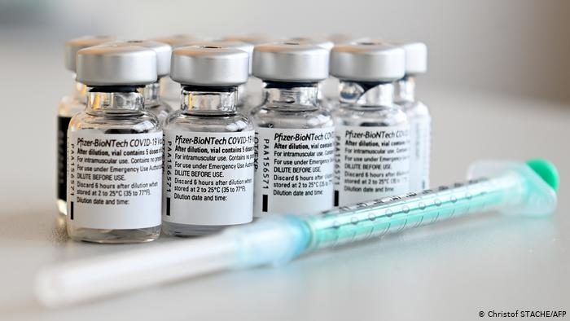
Summary:
VACCINATION MANAGEMENT SYSTEM
.Vaccination Management System.
Key Features:
Appointment Scheduling:
Streamlines the process for individuals to book vaccination appointments.
Optimizes healthcare resources and minimizes wait times.
Inventory Tracking:
Monitors vaccine stock levels in real-time.
Helps prevent shortages and ensures adequate supply.
Patient Record Management:
Digitizes and centralizes patient vaccination records.
Enhances accuracy, accessibility, and data security.
Automated Reminders:
Sends timely reminders for upcoming vaccinations and boosters.
Improves vaccination compliance and public health outcomes.
Reporting and Analytics:
Generates comprehensive reports on vaccination coverage and trends.
Supports data-driven decision-making for healthcare planning.
Accessibility and Integration:
Ensures the system is user-friendly for both healthcare providers and the public.
Integrates with existing healthcare systems for seamless data flow.
Benefits:
Enhances efficiency in vaccine distribution and administration.
Improves data accuracy and accessibility.
Facilitates proactive healthcare planning.

Slide 9




Thank You
Aptech learning center
+1 23 987 6554
aptech@gmail.com
www.aptech.com

